Slide 1

KOLHAPUR INSTITUTE OF TECHNOLOGY’S
COLLEGE OF ENGINEERING KOLHAPUR
(EMPOWERED AUTONOMOUS)
Department of Electronics and Telecommunication Engineering
IoT Based Incident Detection And Path Tracking System With GSM Alert
Guide:
Dr. M. S. Chavan
Project Group No: 24_
Name of Projectees
Ballaleshwar Deshpande Akash Meherkar
Vaishnavi Patil Anuradha Jadhav

Slide 2
Contents
Introduction.
Components Simulation.
Components Prices.
Objectives.
Methodology with Block/Layout Diagram.

Slide 3
Introduction
Accidental falls and disorientation are among the most common risks faced by elderly people and patients with mobility issues. Delay in providing timely help after such incidents can lead to serious health complications. Existing solutions such as smartwatches and health monitoring devices are often costly and not easily accessible to everyone.
This project presents an IoT-based Incident Detection and Path Tracking System with GSM Alert, designed as a low-cost, wearable safety system. The device continuously monitors the user’s motion, detects accidental impacts using an accelerometer and gyroscope, and obtains the user’s live location through GPS. In the event of an accident, it automatically sends an SMS alert with the location to a caregiver via GSM. Additionally, the system logs the user’s walking path and provides guidance to retrace their steps using navigation assistance.
This solution ensures quick communication in emergencies, improves safety for vulnerable individuals, and offers an affordable, portable, and practical device for healthcare and personal monitoring applications.

Slide 4
Components Simulation
Wokwi Simulation Platform
Wokwi is an online IoT and embedded systems simulator that allows users to design, connect, and run microcontroller projects virtually — without any physical hardware.
Simulated Components:
MPU6050 – Accelerometer + Gyroscope sensor simulated to detect motion/fall.
SIM800L (GSM Module) – Used for sending SMS alerts through virtual serial communication.
GPS Module (NEO-6M) – Simulated to provide live latitude and longitude coordinates for location tracking.
Simulation Process:
MPU6050 to ESP32 Connection
The MPU6050 communicates with ESP32 using the I2C protocol. The SDA pin of MPU6050 connects to GPIO21 and SCL to GPIO22 of ESP32. Power pins VCC and GND are connected to 3.3V and GND respectively. The sensor continuously sends acceleration and gyroscope data to ESP32 for motion or fall detection.
SIM800L to ESP32 Connection
The SIM800L GSM module uses the UART interface for communication. Its TX pin connects to RX (GPIO16) of ESP32 and RX to TX (GPIO17). Power is supplied through 3.7–4.2V (from a regulated source). ESP32 sends AT commands to the SIM800L to transmit SMS alerts during incidents.
GPS Module to ESP32 Connection
The GPS module (e.g., NEO-6M) also uses UART communication. The TX pin of the GPS connects to RX (GPIO26) of ESP32, while RX can be left unconnected or linked to TX (GPIO27) if needed. It’s powered through 3.3V and GND. ESP32 receives latitude and longitude data to track the user’s location in real-time.

Slide 5
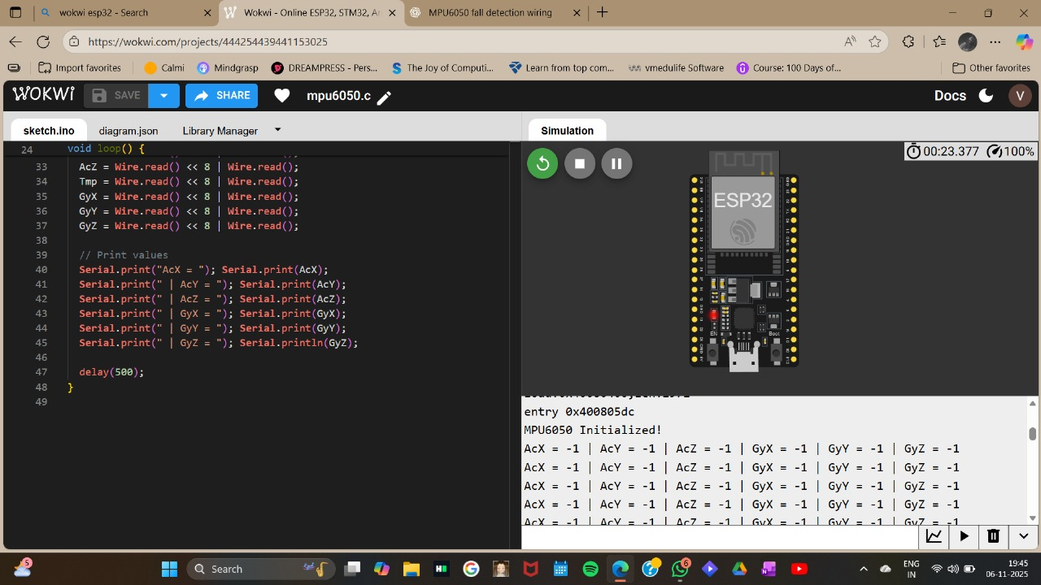
Simulation for MPU 6050

Slide 6
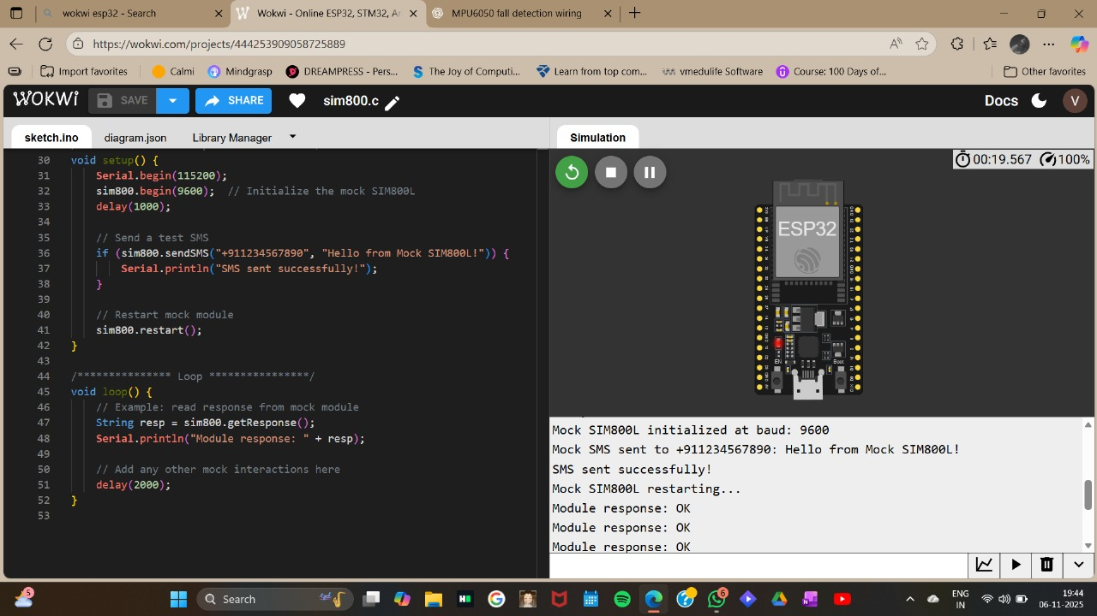
Simulation for SIM800L

Slide 7
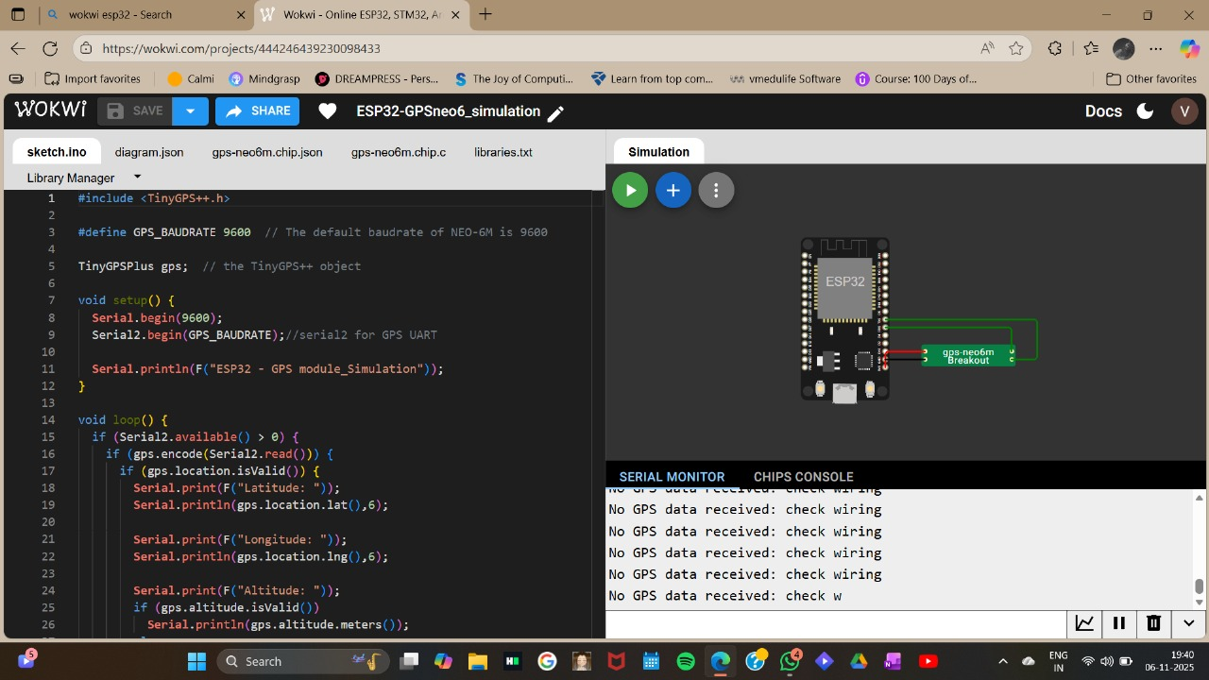
Simulation for GPS

Slide 8
Objectives
The primary aim of this project is to design and implement a low-cost wearable device capable of detecting accidents, providing real-time alerts, and assisting in safe navigation. The specific objectives are:
Incident Detection using IMU (MPU-6050)
Utilize accelerometer and gyroscope data to monitor the user’s body motion.
Implement threshold-based fall detection algorithm to identify sudden impacts, free-fall, or abnormal posture changes.
Ensure accuracy by reducing false alarms through motion pattern analysis.
GPS-Based Path Tracking
Integrate a GPS module (NEO-6M) to record real-time location of the user.
Log breadcrumb points for continuous path tracking.
Enable a retracing feature so the user can safely return to the origin point after disorientation.
Emergency Communication via GSM (SIM800L)
Send an automated SMS alert containing the accident information and live GPS coordinates to caregivers or family members.
Ensure quick communication without relying on Wi-Fi or internet (uses GSM 2G network).
Improve reliability by supporting multiple stored phone numbers for alerts.
User Interaction and Alerts
Provide local feedback using a buzzer, vibration motor, and LED indicators for immediate awareness.
Include an SOS button for manual emergency triggering.
Ensure device is lightweight, portable, and easy to wear.

Slide 9
Objectives
5.Power Management and Portability
Use a rechargeable Li-ion battery with TP4056 charging and voltage regulation circuit.
Optimize the system for low power consumption to extend battery life.
Make the device compact and suitable for daily use.
Beyond these objectives, the project also focuses on enhancing the practical usability of the device. By combining sensing, communication, and navigation features into a single wearable system, it aims to provide a holistic solution for personal safety. The integration of IoT concepts ensures that the device not only detects accidents but also responds intelligently by transmitting real-time data to caregivers. This approach bridges the gap between conventional fall detectors and modern smart healthcare systems, offering an affordable and reliable alternative for elderly care and patient monitoring.

Slide 10
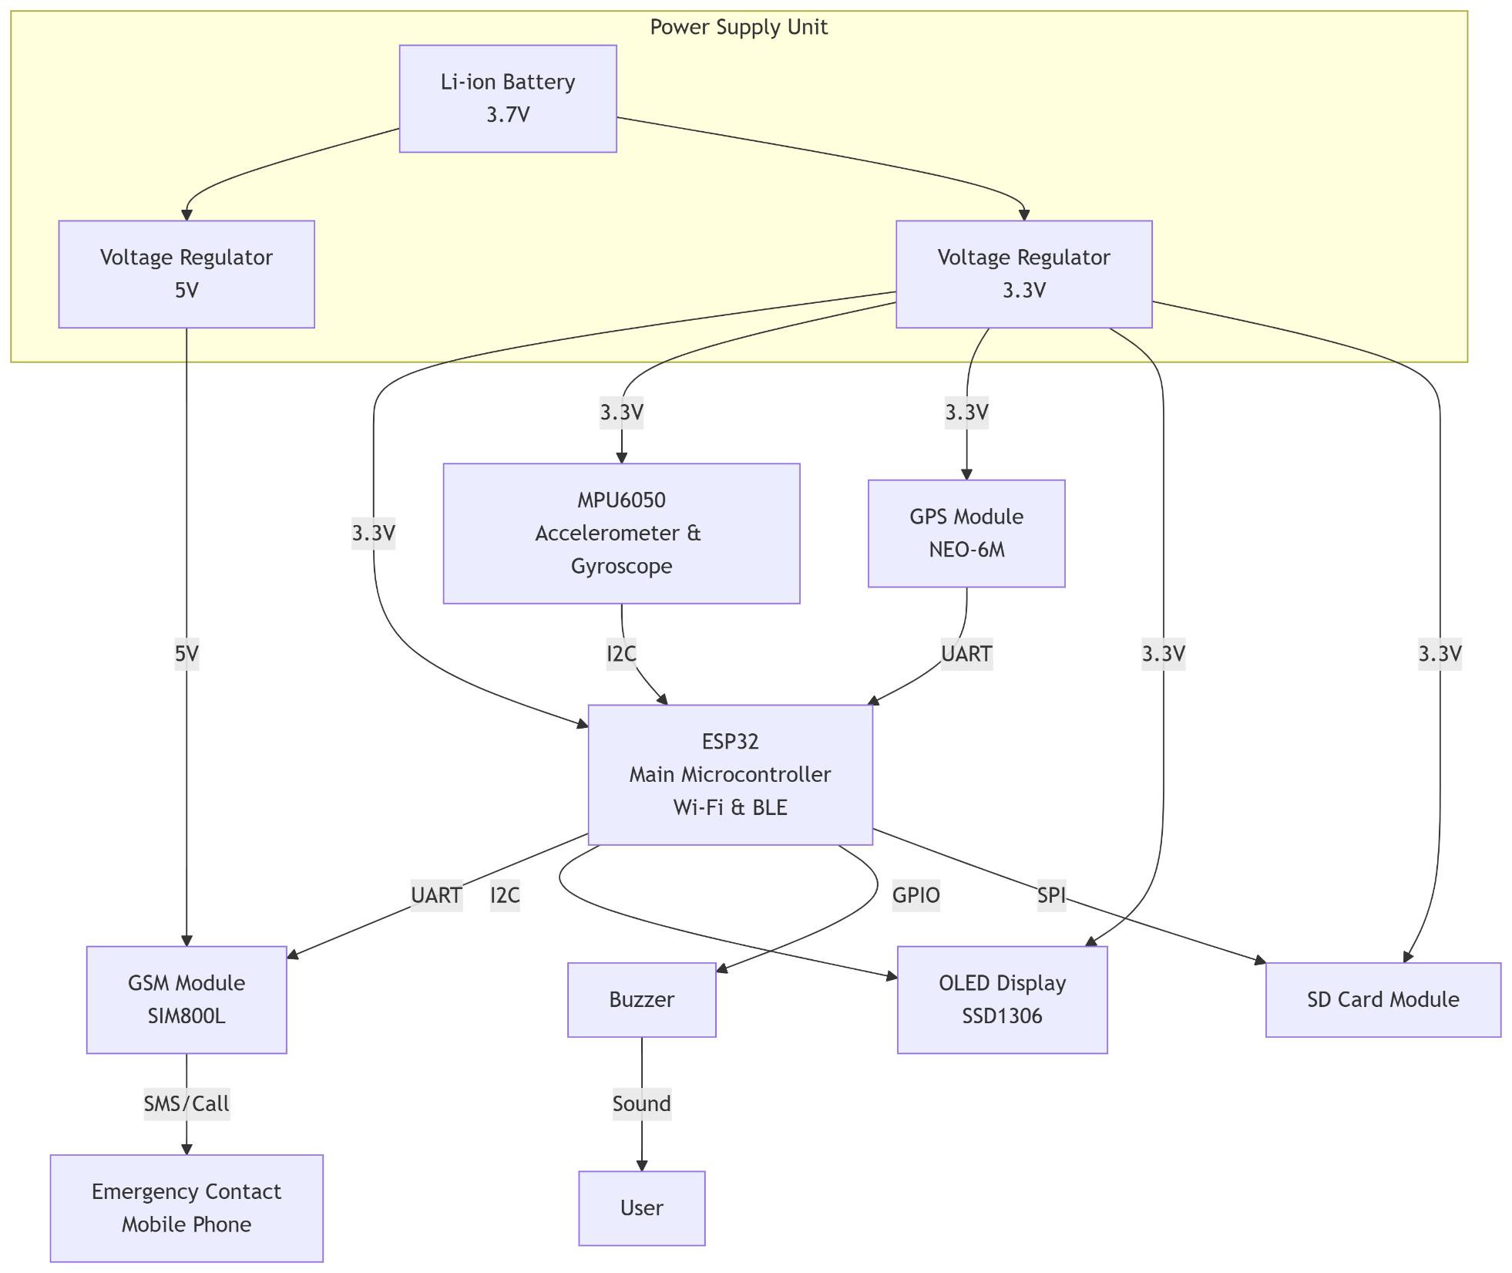
Methodology with Block/Layout Diagram

Slide 11
Components Prices
Component Name | Price
ESP 32 | 400-600rs
MPU 6050 | 150-200rs
SIM 800L | 400-600rs
GPS Module | 400-600rs
Li-on Battery | 250-400rs
TP4056 Charging Module | 40-60rs
Slide Switch and Battery Connector | 200rs
Buzzer , LED , Resistors | 200rs
Total Approx | 2000-2500rs

Slide 12
Acknowledgement
We would like to extend our sincere gratitude to those who have supported the conceptualization and planning of our project, “IoT-Based Accident Detection and Path Tracking Device with GSM Alert.”
A special note of thanks to our guide, Prof. Dr. M. S. Chavan, for his valuable
direction during the initial brainstorming phases. His expertise was instrumental in helping us refine our methodology and define a clear, achievable path forward.
Thank you

